Slide 1
Topological Analysis for Single Cell RNA-seq Data in a Mouse Brain
Zhaoyi Guo

Slide 2
What is single cell RNA-seq and Why is it Significant?

Slide 3
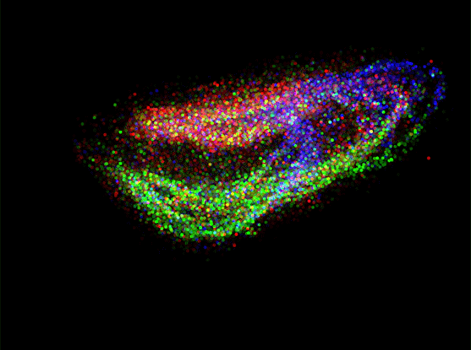
The RNA sequencing data can be use for cellular responses analysis
A genomic approach for the analysis of RNA molecules in a biological sample and is useful for studying cellular responses
provide innovation in medicine and implicate important biomarkers
https://www.broadinstitute.org/files/news/images/2019/Projections_of_Composite_MainStoryPage_1.gif
Notes:
RNA sequencing (RNA-seq) is a genomic approach for the detection and quantitative analysis of messenger RNA molecules in a biological sample and is useful for studying cellular responses.
RNA-seq has fueled much discovery and innovation in medicine over recent years. For practical reasons, the technique is usually conducted on samples comprising thousands to millions of cells.
The graph shown on the right is A three-dimensional reconstruction of nine cubic millimeters of mouse hippocampus profiled with Slide-seq where the colors indicate different cell types

Slide 4

This Project
Computing topological persistence profile for Rips filtration
Exploring the space behind high dimensional RNA-Seq data using the Mapper methodology
https://www.pinterest.com/pin/66991113196201018/
Notes:
Using the single-cell RNAseq data, which is high dimensional pointclouds, I will Compute its topological persistence profile for Rips filtration.
Also, I will explore the space behind high dimensional RNASeq data using theMapper methodology

Slide 5
Pipeline Overview
Download Data
Persistence Diagram
UMAP
Notes:
I first downloaded the data. After obtaining the dataset, I used the python package Pandas for quality control and data cleaning. After the RNA sequences were ready, I used Persistence Diagram to compute topological features of a space at different spatial resolution. In addition to Persistence Diagram, I utilized the UMAP which stands for (Uniform Manifold Approximation and Projection) to learn the manifold structure of my data and find a low dimensional embedding that preserves the essential topological structure of that manifold.

Slide 6
The Datasets

Slide 7
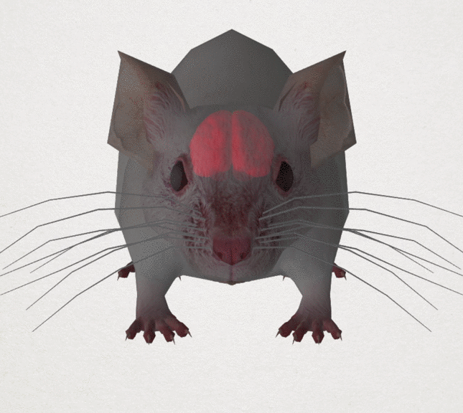
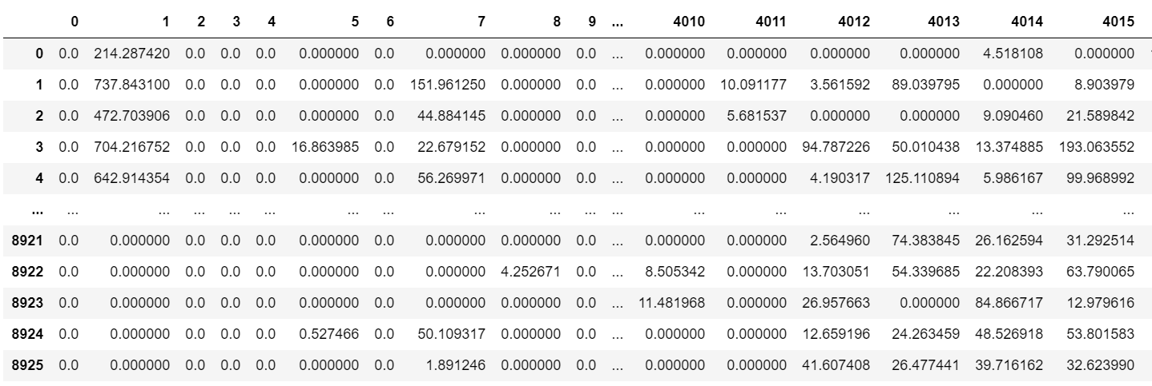
The Dataset - Main
https://www.statnews.com/wp-content/uploads/2016/02/CONCUSSION_MOUSE_WIDE-645x576.gif
Notes:
The datasets consist of the gene expressions (vectors) of single cells in a mouse brain. In particular, this is for cells only found in the ALM region of the brain, where ALM stands for (anterior lateral motor cortex) . A recent finding found that ALM can not only guide and plan movement, but it can also do decision making in mice. So finding the topological features for single cells in the ALM region could help us understand how decision making work for mice better.
I used two datasets for my project analysis. The main dataset contains the vectors. Each row is a cell, and each column is a specific gene. The value in the Xth row and Yth column can be thought of as a gene expression measurement for the amount of gene Y found in cell X. There are 8925 cells and 4020 genes in this dataset.

Slide 8
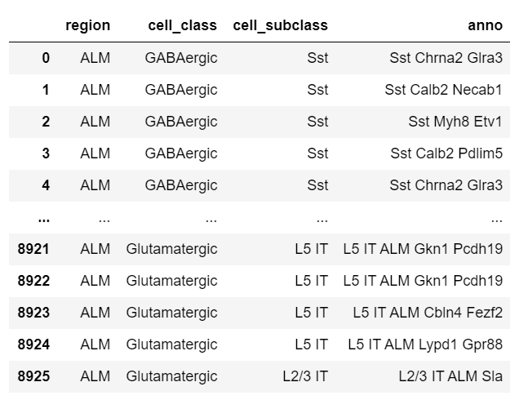
The Dataset - Secondary Information
Notes:
The second dataset I used
contains the annotations for each cell.
The first column indicates region of the brain - in this case every row will have ALM
Next is the cell class - this will either be GABAergic or Glutamatergic.
Next column is the cell subclass,
and the final column is a leaf level annotation
.

Slide 9
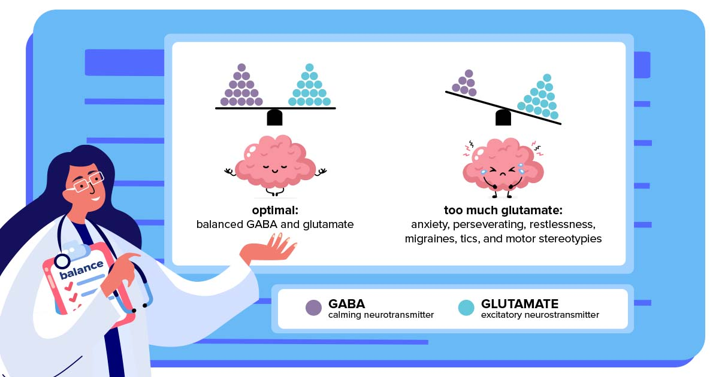
GaBAergic and Glutamaergic
https://tacanow.org/wp-content/uploads/2020/10/Glutamate-and-Autism-Balanced-Glutamate-and-Autism.jpg
Notes:
Before we move on to analysis, I want to explain a little bit on GABAergic and Glutamatergic. As we can see in the secondary dataset, the second column is either GABAergic and Glutamatergic. But what are they?
A GABAergic or GABAergic agent is any chemical that modifies the effects of GABA in the body or brain.
GABA is considered an inhibitory neurotransmitter because it blocks, or inhibits, certain brain signals and decreases activity in your nervous system.
A glutamatergic agent (or drug) is a chemical that directly modulates the excitatory amino acid (glutamate/aspartate) system in the body or brain.
Glutamate is a powerful excitatory neurotransmitter that is released by nerve cells in the brain. It is responsible for sending signals between nerve cells, and under normal conditions it plays an important role in learning and memory.

Slide 10
Analysis, and Results
The methods I used for our project.

Slide 11
Persistence Diagram: Pipeline (Gudhi)
Distance Matrix
Persistent Intervals
Persistance Diagram
Euclidean
Manhattan
Rips
H0
H1
Cosine
Plot For H0 and H1
The Most Persistent point
Notes:
The first analysis I did is to compute its topological persistence profile for Rips filtration using the Gudhi software in jupyter Notebook.
I first compute the distance matrix. I tried 3 kinds of metric: Euclidean, Manhattan and Cosine to make a comparison.
Then, I computed the persistence diagram induced by the Rips filtration. I accessed to the persistence intervals per dimension.
After than, I plot the persistence diagram for H0 and H1 in two separated plot, and keep track of the largest persistent point for each persistence interval.

Slide 12
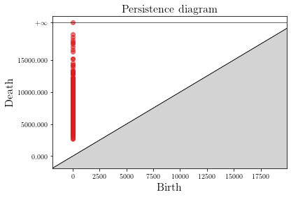
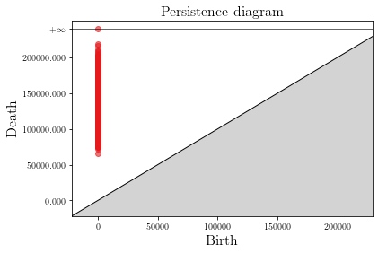
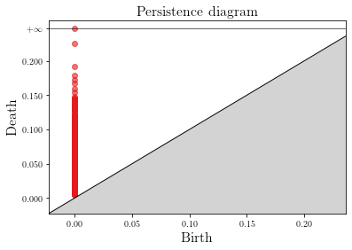
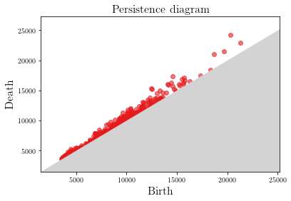
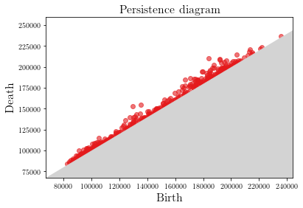
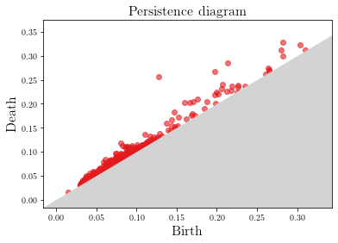
Persistence Diagram: Result (Gudhi)
Euclidean
Manhattan
Cosine
H0
H1
Notes:
So these are the persistence diagrams.
We can see there are distinctive difference in the locations of the point cluster.
Especially, for the second dimension, persistence diagram of Euclidean have more points gather from the birth of 6000 to 14000.
The persistence diagram of Manhattan have more points gather from the birth of 170000 to 220000.
The persistence diagram of Cosine have more points gather from the birth of 0.03 to 0.13.

Slide 13
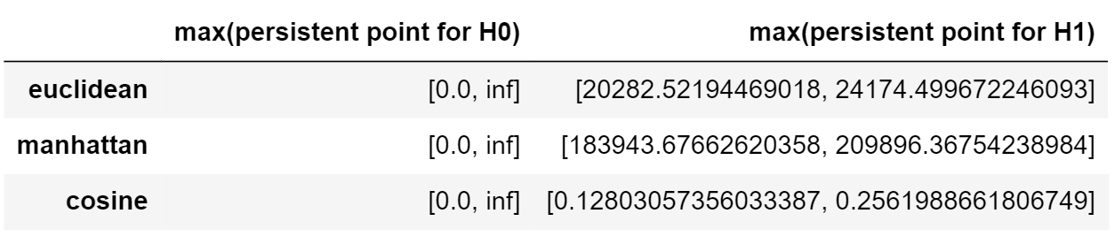
Persistence Diagram: Result (Gudhi)
Notes:
And these are the most persistent point for each persistence diagram.
We can see there are distinctive difference in scale.
Although all three of the most persistent point for H0 are infinity, all three of the most persistent point for H1 are drastically different.
the most persistent point for Manhattan is the largest, and the most persistent point for Cosine is the smallest.
It is no wonder this happens, because the cosine distance between X and Y is the angle between the two vectors. Cosine similarity is used to determine how similar two vectors are. Values will be between -1 and 1. Thus, cosine distance is between 0 and 2.
On the other hand, The Manhattan distance between two points x and y in n-dimensional space is the sum of the distances in each dimension, so it is greater than the Cosine distance and the Euclidean distance.

Slide 14
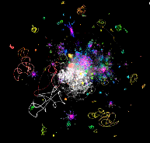
A Quick Background on UMAP
A flexible non-linear dimension reduction algorithm.
Competitive with t-SNE for visualization quality.
Find a low dimensional embedding that preserves the essential topological structure.
https://johnhw.github.io/umap_primes/imgs/umap_rotates.gif
Notes:
The second analysis I did is UMAP. Before I talked about the analysis, I want to explain a little on UMAP. UMAP is a fairly flexible non-linear dimension reduction algorithm that applies to real world data. It seeks to learn the manifold structure of your data and find a low dimensional embedding that preserves the essential topological structure of that manifold.
The UMAP algorithm is competitive with t-SNE for visualization quality, and arguably preserves more of the global structure with superior run time performance. Furthermore, UMAP has no computational restrictions on embedding dimension, making it viable as a general purpose dimension reduction technique for machine learning.

Slide 15
UMAP: Pipeline
Basic Library
Lower Dimensional Representation
Visualize the Result
metric
min_distance
n_components
n_neighbors
Notes:
So this is the pipeline I use to implement UMAP.
To start off, I downloaded the basic libraries for UMAP.
Then, using UMAP, I found the low dimensional representation of the data by fit and transform the data. Then, I visualize the result using matplotlib to draw a scatter plot of the transformed data.
Because UMAP has several hyperparameters than can have a significant impact on the resulting embedding. I look at metric, n_components, n_neighbors, and min_distance.

Slide 16
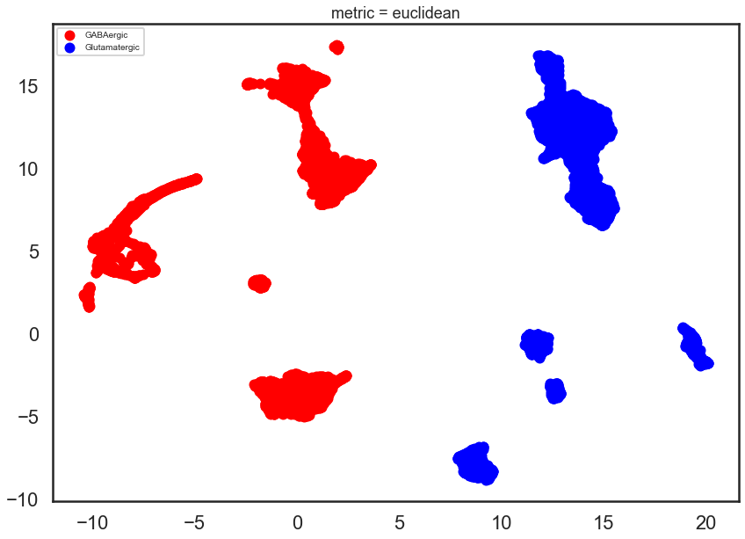
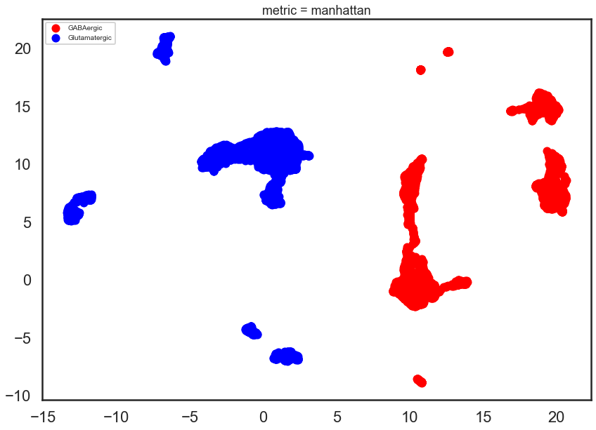
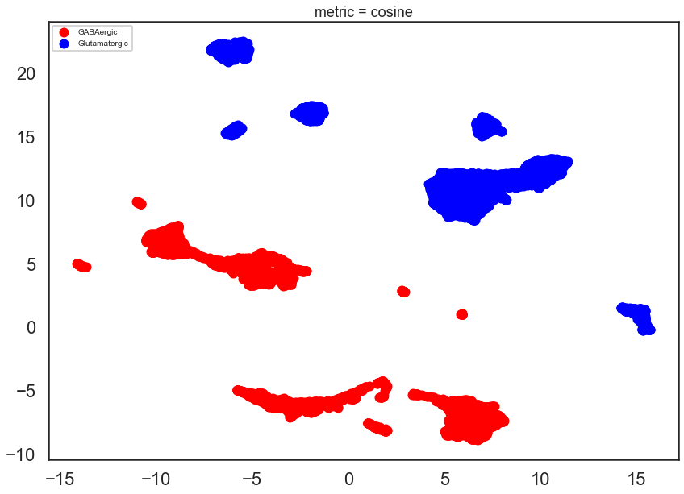
UMAP – metric
Euclidean
Manhattan
Cosine
A collection of gene counts
Notes:
The first parameters I considered is metric. The metric parameters controls how distance is computed.
I used eculidean, mannattan, and cosine, because I also tried these three matrics for my persistence diagrams.
We can see that for all of these metrics, they are all able to separate chemical agents GABAergic and Glutamatergic.

Slide 17
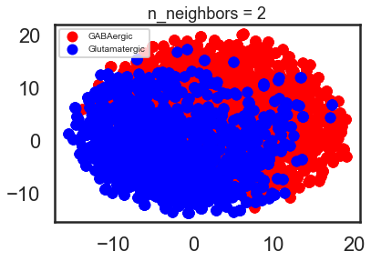
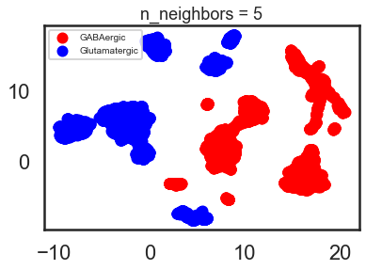
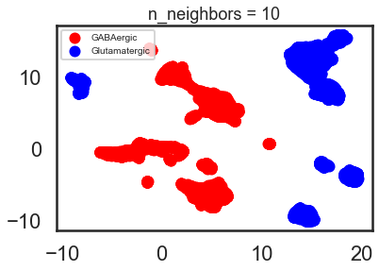
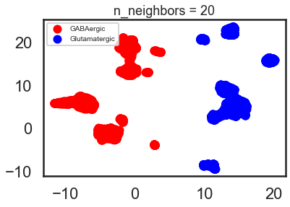
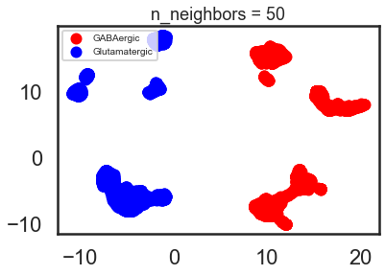
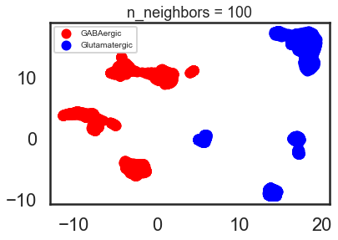
UMAP – n_neighbors
A collection of gene counts
Notes:
The next parameter I looked at is n_neighbors. This parameter controls how UMAP balances local versus global structure in the data. It does this by constraining the size of the locaal neighborhood UMAP. So that low values of n_neighbors will force UMAP to concentrate on very local structure. Just like we see on the graph when n_neighbors=2. Both chemical agents become one big cluster in the middle. While as n_neighbors increases, it pushed UMAP to look at larger neighborhoods of each point when estimating the manifold structure of the data, losing fine detail structure for the sake of getting the broader of the data.

Slide 18
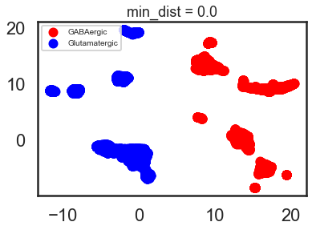
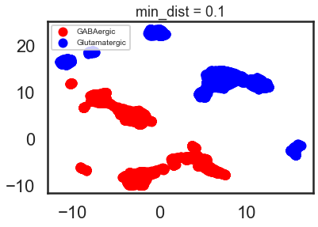
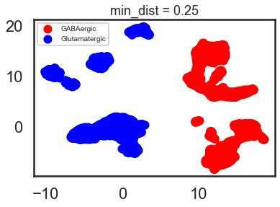
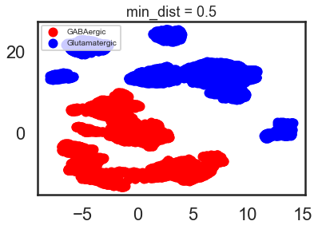
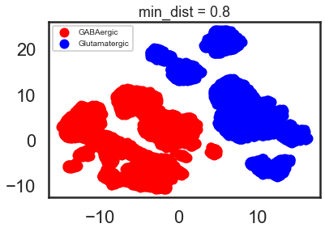
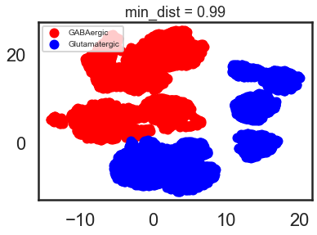
UMAP-min_dist
Notes:
The min_dist parameter controls how tightly UMAP is allowed to pack points together. It provides the minimum distance apart that points are allowed to be in the low dimensional representation. This means that low values of min_dist will result in clumpier embeddings. This can be useful if you are interested in clustering, or in finer topological structure. Larger values of min_dist will prevent UMAP from packing points together and will focus on the preservation of the broad topological structure instead.

Slide 19
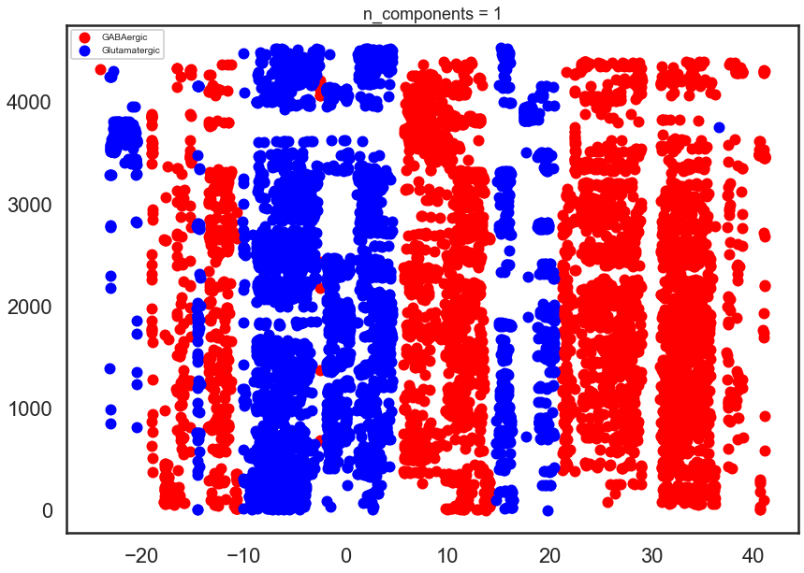
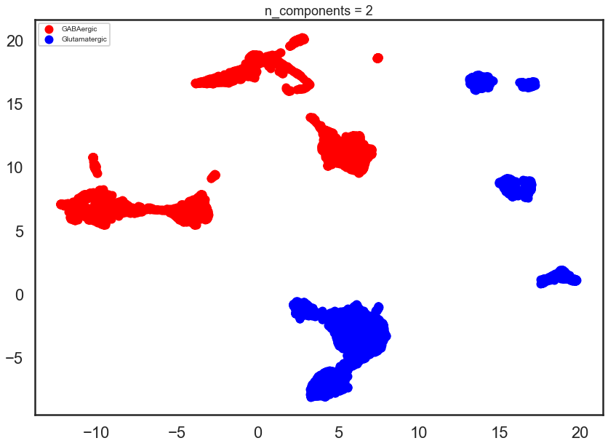
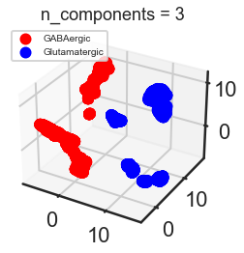
UMAP – n_components
1-Dimension
2-Dimensions
3-Dimensions
Notes:
Since UMAP provides us n_components parameter option, so I decided to use this parameter to determine the dimensionality of the reduced dimension space I embedded the data into. The last parameter I looked at is n_components, and I first set n_components to 1, forcing UMAP to embed the data in a line. Although there are separations between GABA and Glutamate, there are a few red dots of GABA in the blue clusters of Glutamate, and blue dots of Glutamate in the red clusters of gaba, so the separation is not very clean.
However, when n_component = 2, the separation between GABA and Glutamate becomes clear, and when n_component = 3, the separation between them become distinctive.
Therefore, the more dimensions in which to work UMAP, the easier it is to separate out the color in a way that respects the topological structure of the data.

Slide 20
Conclusion

Slide 21
Topological Analysis for Single Cell RNA-seq Data
Persistence Diagram
Among all 3 metrics, Manhattan has the largest scale (over 200000), while Cosine has the smallest scale (under 0.35).
UMAP
The Higher Dimensions to work UMAP, the easier to preserve the topological feature of the data.
Notes:
In this study, we presented topological analysis for single cell RNA-seq DATA associated with the ALM region in mouse.
By doing this, I found the topological features by computing the persistence diagrams with difference distance metrics.
Also, I did dimension reduction, and found global structure of the data UMAP using different parameters.
Here are some of the important findings in our study:
Persistence Diagram with different distance metrics can be drastically different in scale. Manhattan has the largest scale, while Cosine has the smallest scale among all three.
For UMAP, the higher dimensions reserved from UMAP, the easier it is to separate out the color in a way that respects the topological structure of the data.

Slide 22
Thank you!
Notes:
OK that’s the end of our presentation. Thank you for listening.

Slide 23
Citations
https://umap-learn.readthedocs.io/en/latest/parameters.html
https://genomemedicine.biomedcentral.com/articles/10.1186/s13073-017-0467-4
https://www.intechopen.com/books/gaba-and-glutamate-new-developments-in-neurotransmission-research/gaba-and-glutamate-their-transmitter-role-in-the-cns-and-pancreatic-islets

